Slide 1
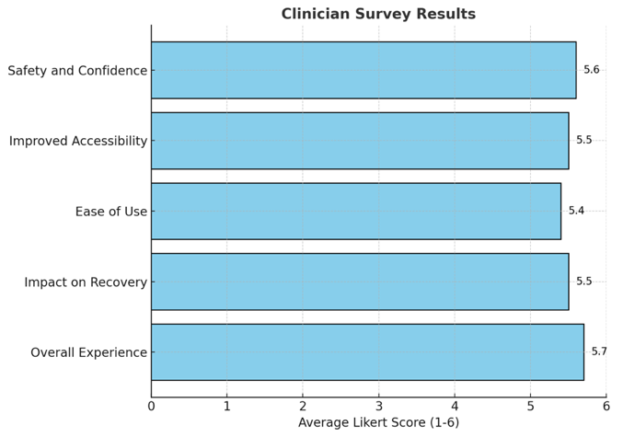
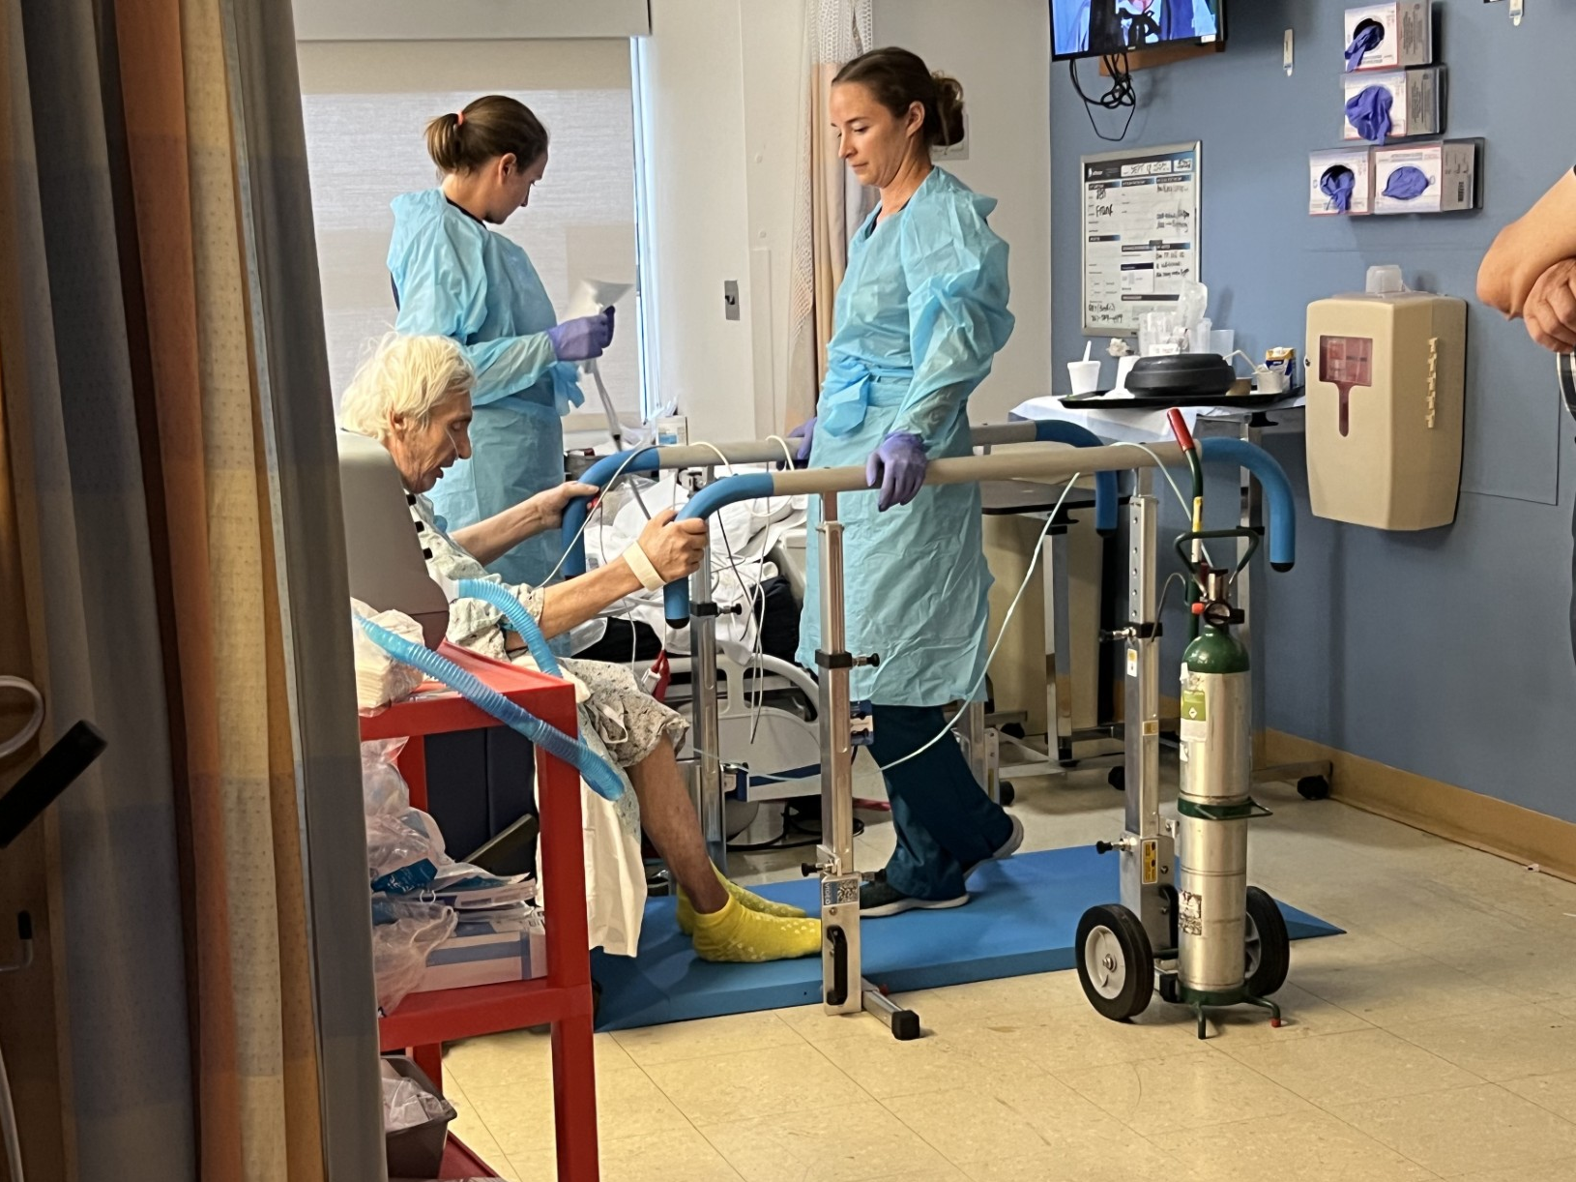
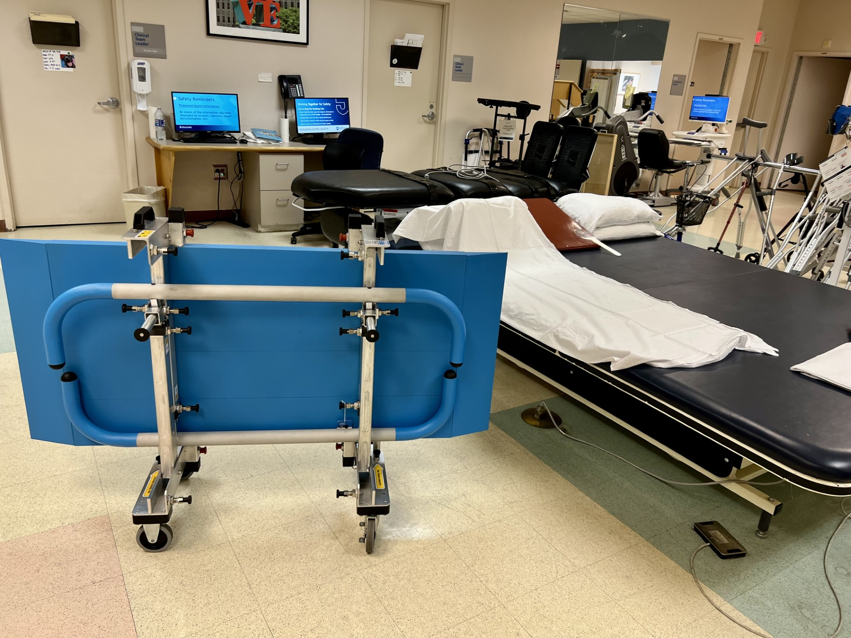
Get Patients Back on Their Feet: Overcoming Typical
Barriers to Early Mobilization Maegen Johnson, PT, DPT; Mary Lynn Hafner, PT, DPT, CEEAA, CHC, CAPS; Gina Adams, MBA; William Levy
Background
Survey Insights
Case Example
Early mobilization is a proven, high-impact intervention that improves patient outcomes across critical care settings. Studies show that benefits of early mobilization include reduced length of stay, decreased complications, and improved physical function.
Despite these benefits, immobility remains a persistent challenge in the acute care environment, especially in the ICU. Research demonstrates that patients can lose 2–3% of muscle mass within the first 7–10 days of immobility, as well as up to a 12.5% reduction in quadriceps muscle fibers occurring with just one week of bedrest.
Common barriers to early mobilization include:
Patient - hemodynamic instability, presence of lines/tubes, sedation
Cultural – limited awareness of the benefits, lack of staff engagement
Process - inadequate planning or screening for mobility readiness
Structural – insufficient staffing, training, or access to equipment
Early mobilization is safe and carries less than a 3% chance of an adverse event occurring. Additionally, it has not been found to increase adverse events or mortality overall.
A survey of clinicians using the portable parallel bar system revealed a high level of satisfaction (average 5.5/6 on a Likert scale), with key findings including:​
Safety and Confidence: Clinicians reported feeling safe using the device (Item 1) and observed increased patient confidence(Item 2).​
Improved Accessibility: The mobility of the tool enhanced patient access to treatment (Item 3) and supported patient movement, standing, and exercising (Item 4).​
Ease of Use: Clinicians found the portable parallel bars easy to use (Item 5).​
Impact on Recovery: There was consensus that the tool improves recovery outcomes for complex patients (Item 6).​
Overall Experience: Clinicians reported a positive experience(Item 7) and expressed a willingness to recommend the tool.
Below is a case example of utilization of the portable parallel bar system to facilitate early mobilization for a patient on ECMO in the cardiac ICU.
56 year old male with history of CHF, Diabetes, and Autoimmune Interstitial Lung Disease, admitted for shortness of breath and subsequent lung transplant work up.
Hospital course was complicated by PEA arrest requiring intubation and ECMO cannulation.
Therapy evaluation: Lower extremities grossly 2-/5, upper extremities grossly 1 to 2-/5, required total assist for all bed mobility.
Sit to stand initial trial only able to complete ~ 50% of a stand with total assist of 2
Decision made to utilize portable parallel bars for standing/mobility
With parallel bars, patient able to complete standing trial with maximum assist of 2 for 10-15 second intervals
On third session with parallel bars, patient was able to complete short distance ambulation forwards/backwards with moderate assist of 2.
Patient completed a total of 10 therapy sessions with the portable parallel bars before progressing to ambulation with a cardiac walker.
Total days on ECMO: 92 days
Purpose
This quality improvement project aimed to reduce process and structural barriers by introducing a foldable, mobile parallel bar system at the bedside for early standing and gait training.
Discussion
This quality improvement project demonstrates clinician satisfaction and confidence in utilizing the portable parallel bar system to facilitate early mobilization. This intervention has the potential to reduce clinician strain and improve both patient outcomes and workforce safety by supporting weight-bearing activities earlier in the recovery process. Additionally, the survey results indicate that clinicians perceived a correlation between utilization of the portable parallel bars and improved patient recovery outcomes.
Takeaway: The portable parallel bar system facilitated clinician safety and confidence with patient mobility, enabling earlier mobilization in the ICU setting in attempt to decrease patient deconditioning while hospitalized.
Limitations: since this is a quality improvement study, the only data obtained is clinician satisfaction with the device as well as clinician perception of impact on patient outcomes. It would have been beneficial to obtain data on utilization of the portable parallel bar system on patient outcomes, including length of stay, time from admission to initial mobilization out of bed, and time from initial standing with portable parallel bars to walking with assistive device.
Future implications: case studies to determine impact on patient recovery and length of stay
References
Methodology
Klein K, Mulkey M, Bena JF, Albert NM. Clinical and psychological effects of early mobilization in patients treated in a neurologic ICU: a comparative study. Crit Care Med. 2015;43(4):865-873. doi:10.1097/CCM.0000000000000787
Paton M, Chan S, Serpa Neto A, Tipping CJ, Stratton A, Lane R, Romero L, Broadley T, Hodgson CL. Association of active mobilisation variables with adverse events and mortality in patients requiring mechanical ventilation in the intensive care unit: a systematic review and meta-analysis. Lancet Respir Med. 2024 May;12(5):386-398. doi: 10.1016/S2213-2600(24)00011-0. Epub 2024 Mar 18. PMID: 38513675.
Kwakman RCH, Voorn EL, Sommers J, Gerrits K, Nollet F, Engelbert RHH, van der Schaaf M. Metabolic load during morning care and active bed exercises in critically ill patients: An explorative study. Aust Crit Care. 2024 May;37(3):441-447. doi: 10.1016/j.aucc.2023.04.006. Epub 2023 Jun 5. PMID: 37286446.
Medrinal C, Combret Y, Prieur G, et al. Comparison of exercise intensity during four early rehabilitation techniques in sedated and ventilated patients in ICU: a randomised cross-over trial. Crit Care. 2018;22(1):110. doi:10.1186/s13054-018-2030-0
Dubb R, Nydahl P, Hermes C, et al. Barriers and strategies for early mobilization of patients in intensive care units. Ann Am Thorac Soc. 2016;13(5):724-730. doi:10.1513/AnnalsATS.201509-586CME
In collaboration with the Thomas Jefferson University Hospital ICU team and Environmental Health and Safety department, a mobile parallel bar system was piloted in November 2023.
Patients who met criteria for activity and required physical assistance for mobility were selected for parallel bar treatment sessions. Patients were mobilized daily during the week as medically indicated. Sessions were documented in the patients’ medical record.
A preliminary efficacy survey was sent to gauge clinician and patient satisfaction with the device. The survey implemented a 6-point Likert scale (1 = strongly disagree, 6 = strongly agree) assessing 5 critical quality assurance metrics: Safety and Confidence, Improved Accessibility, Ease of Use, Impact on Recovery and Overall Experience.

